Slide 1
Computer Science 20
VARIABLES

Slide 2
A way to remember
So far we have looked at several key building blocks used in designing solutions through computation:
Sequences of Instructions
Decision-making structures (Branching)
Repetition (Looping)
One thing we are missing so far, however, is a way for our programs to store and retrieve (remember) information.

Slide 3
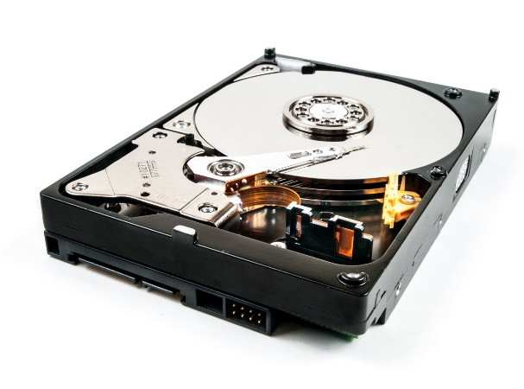
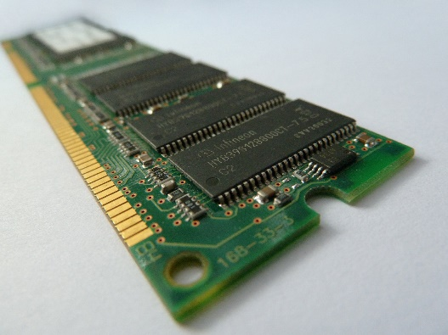
Computer Memory
Computers need to store a lot of information in order to operate, and typically do so in two separate ways:
PERSISTENT MEMORY
This type of storage keeps track of the information even when your device is turned off. Long term storage (SSD, external HDD, memory cards)
Useful for documents, photographs, music, etc…
VOLATILE MEMORY
This memory is more temporary, and is wiped whenever the power is turned off. Not typically used directly by user, but instead by applications. (RAM, Cache)

Slide 4
Variables
MEMORY YOU CAN USE
When you are designing programs, Variables are memory that you can make use of.
A variable is a container that can store a piece of information.
We might want to use a variable to:
Store the value of a user’s name
Keep a running tally of the score in a game
Compute a value to be outputted to the screen
In Scratch, variables use persistent memory.
Values are not lost when the program is over!

Slide 5
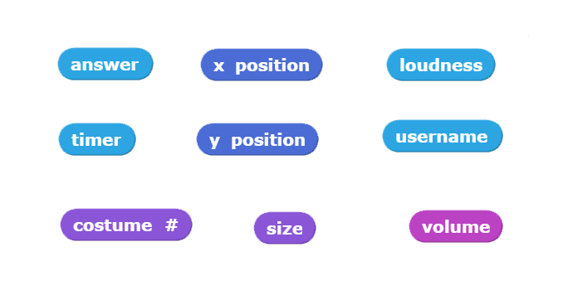
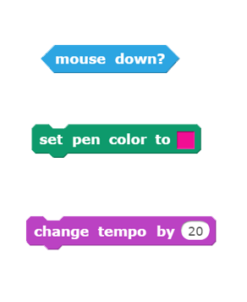
Built in Variables
We’ve already seen and used some of the built-in variables in Scratch:

Slide 6
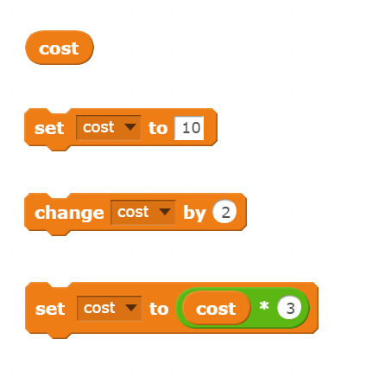
User-Defined Variables
Orange blocks can be used to create custom Variables.
Variable names should be descriptive and relevant its intended use.
Typically you will create one variable for each piece of information we want to keep track of.
Values stored inside variables can be modified during the time that a program is running.

Slide 7
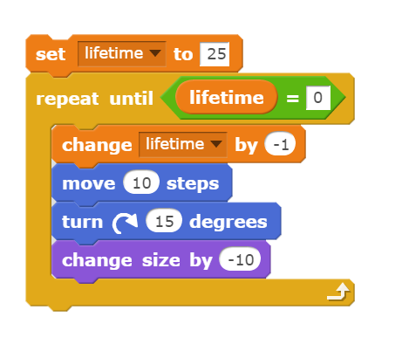
User-Defined Variables
Variables can hold one piece of information at a time.
However, when you create a variable – it is like an empty container. (no value)
Before a variable can be used, it must be initialized to a starting value
During execution we can modify its value
We can also access its value for decision-making or calculations.

Slide 8
Variable Types
Variables are containers that can hold one piece of information.
However, there are different “types” of information that can be stored
In Scratch, we really only need to distinguish between two types:
Numeric: 1 15 2.3 -200.9
String: “Cat” “hello123” “Mr. Scott!”

Slide 9
Activity – Data Collector
Create a script that uses the ASK block to ask the user a series of questions. Store each answer in a separate appropriately named variable.
What is your name?
How old are you?
What is your favourite class?
Create another variable called days_old
Set this variable to be equal to how old the user is in days.
Recall that there are 365.25 days in a year
For experts: Take into account the days since their last birthday!
Have the sprite summarize the information stored in all four variables.

Slide 10
Activity Two – Math Grapher
Given two points in a Cartesian Coordinate System, (x1, y1) and (x2, y2), we can calculate the slope of the line with the following formula:
Create a program that asks the user for 4 numerical values and store them each in a separate variable (x1, y1, x2, y2).
Using the values stored in those variables, have Scratch draw a line between the two points, and then calculate and report the slope of that line.
y2 - y1
__________
m =
x2 - x1

